Slide 1
MYSTERY ILLNESS IN THE DHALA VALLEY
Dr Áine McCoy

Slide 2
SECRET
Social Conditions in The Dhala Valley February 1944
Dr John Henry McCoy MB DPH
Medical Officer RAF Aden

Slide 3


Slide 4
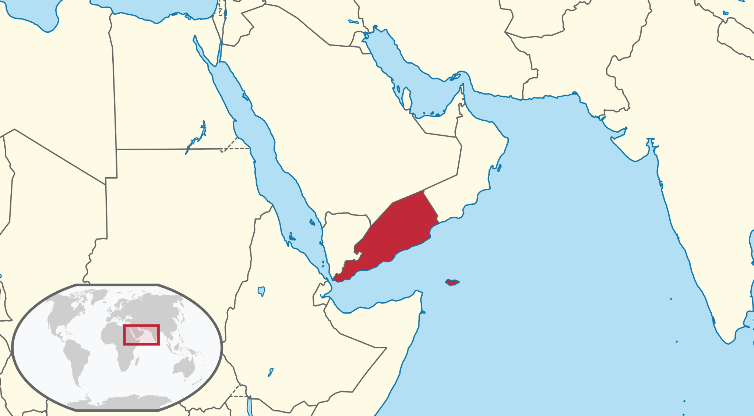
The Dhala Valley was in the Western Aden Protectorate

Slide 5
Aden Protectorate and Aden
1836 Captured by the East India Company
1868 Protectorate formed : hinterland around Aden, and the Hadhramaut
However, Aden and port were kept separate under direct British Sovereignty
1928 Aden Command established under the RAF
1944 Middle East Command (Aden)

Slide 6
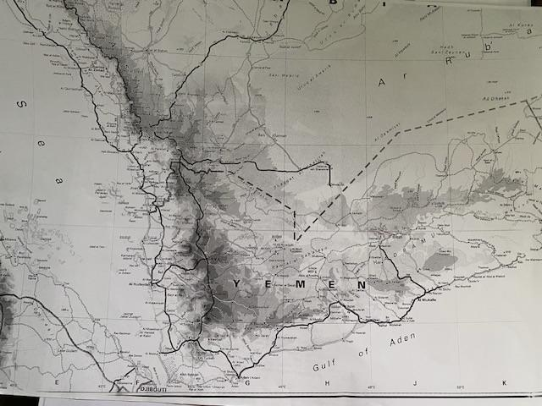

Slide 7
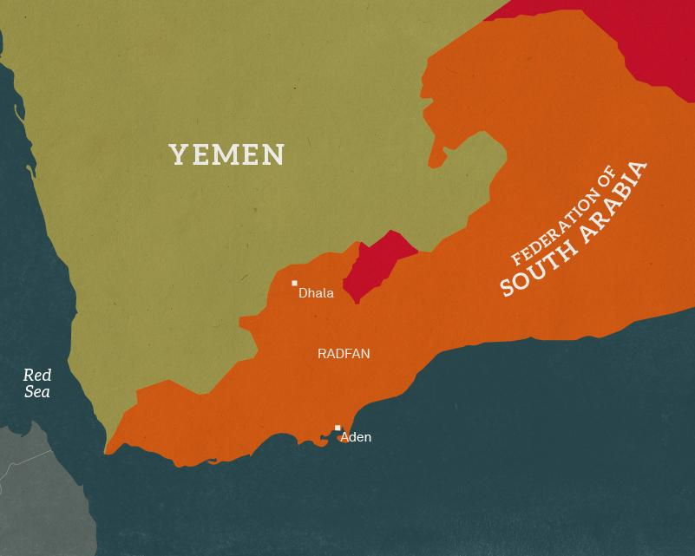

Slide 8
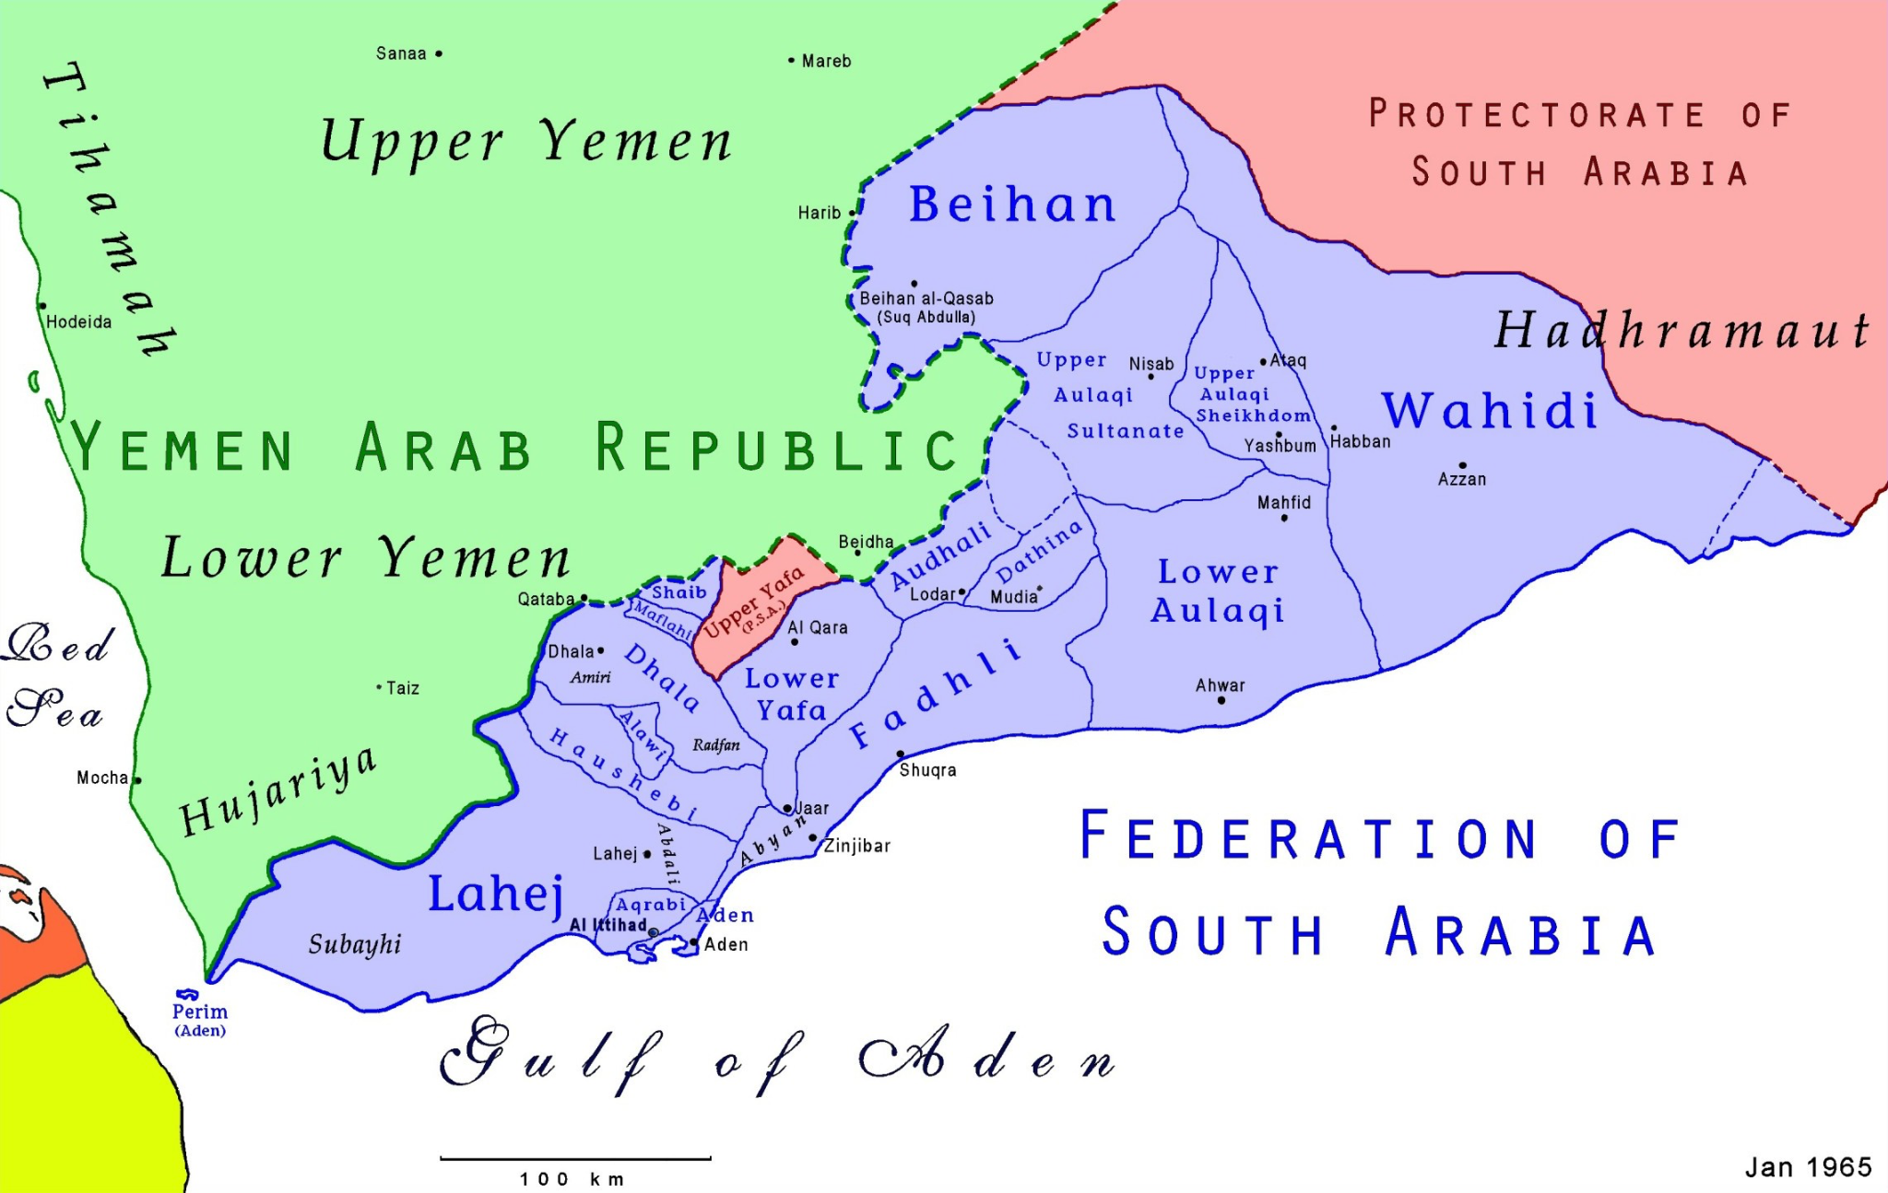

Slide 9
Population
Peasants
Merchants
Seyyids

Slide 10
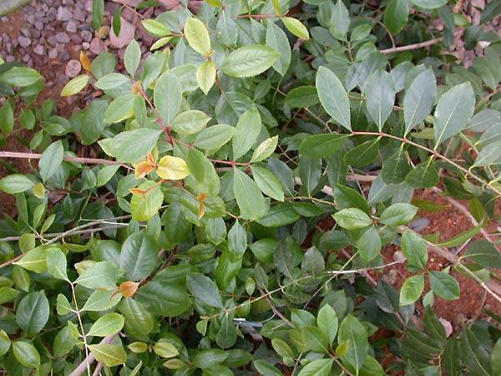
The Khat Plant

Slide 11
Symptoms
First week: fever, shivering, intense headache
Rash appears on Day 3-4, occasionally Day 5 , affecting chest, abdomen and limbs. Discharge noted from eyes
Day 8 coma with delirium. In addition sometimes the face limbs and trunk become enormously swollen
Blackening of the rash heralded death soon afterwards

Slide 12
Convalescence
Deafness
Muscle weakness with difficulty in walking
General emaciation
Headache
Persistence of generalised swelling- if it had occurred during the illness
Lasted 12 days
No recurrence of the illness

Slide 13
Epidemic Typhus
Other names: Camp fever, jail fever, war fever.
Caused by the bacterium Rickettsia Prowazekii
Spread by body louse.
Was the cause of great disease scourges in past centuries associated with poverty and overcrowding. The Irish Potato Famine was one notable example.
Treatment is with the antibiotics chloramphenicol and tetracyclines.
Vaccine is available since WW 2

Slide 14
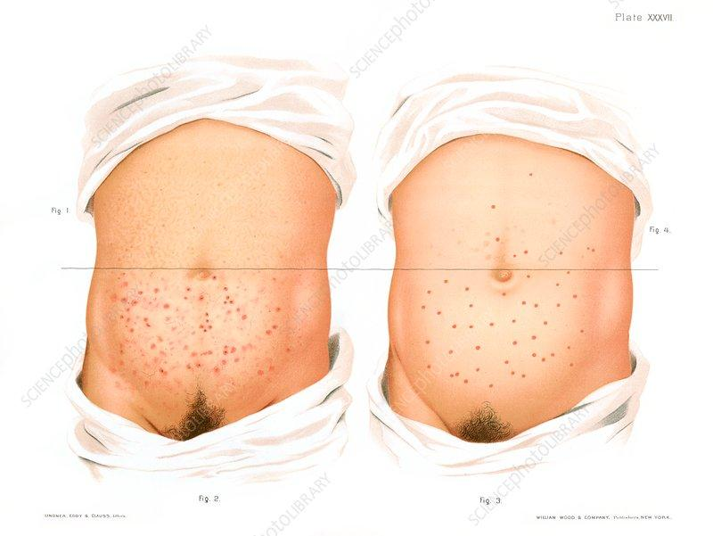
Epidemic Typhus Rash

Slide 15
Typhoid
Caused by Salmonella Typhi, spread through infected faeces or urine.
Symptoms: high fever, stomach cramps, anorexia, fatigue and a rash of small pink spots affecting the trunk.
Duration 3-4 weeks.
Untreated, death occurs 1: 5
Mortality; 1: 5 ( untreated)
Treatment: antibiotics- fluoroquinolones, cephalosporins, macrolides, carbapenem.
Vaccine is available

Slide 16
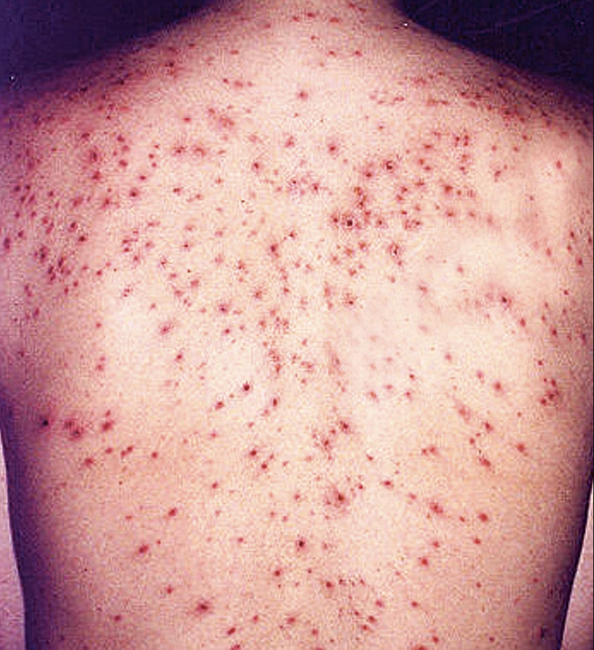
Typhoid Rash

Slide 17
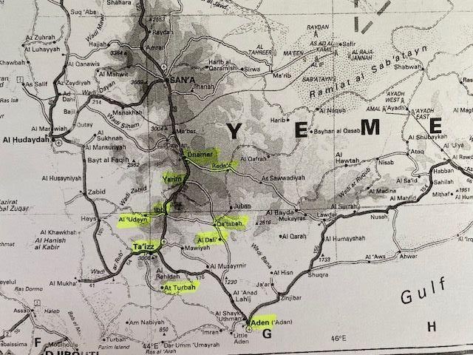
Deaths in Lower Yemen
Taiz 2000+
Turbat 300
Odain and District 1800
Ibb and district 4000-7000
Damar 400+
Rada 400
Yancem 300
Katabah 200

